Slide 1

Cognitive radio
Dinu John K
Chairman IEEE SCET SB

Slide 2
What is Cognitive ?
cognitive means smart
Thus smart radios
Have two parts
The programming part and the hardware part
Cognitive radio is also called SDR- Software Defined Radio
First researched and implemented by Nokia

Slide 3
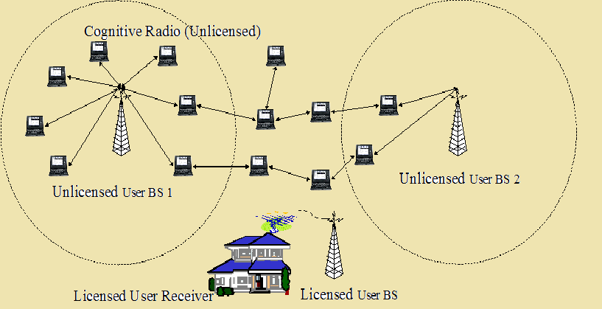
Pictorial representation

Slide 4
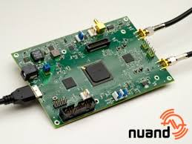
Hardware

Slide 5
Discription
It hardware which make use of a processor to create a Radio waves.
The radio wave is created using PWM
This excites the antenna with required frquency
Commonly

Slide 6
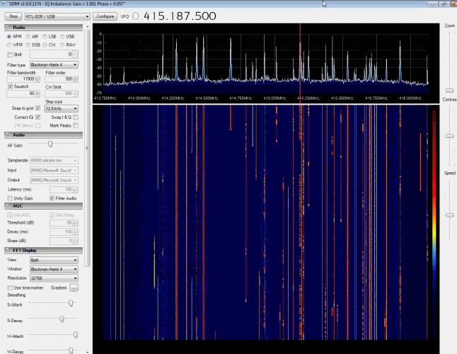
Software

Slide 7
Discription
Requires a real time OS to generate the signals
OS is used to give brain for the radio
We can create a SDR in our computers
SDR software

Slide 8
Can we do it?
U will need a Processor
Which is ur computer
The software

Slide 9
What will you get now?
Your own FM radio broad cast station
If your own raspberry pi you can create a 24 hour radio station
Use the vacant frequency so you won't be breaking any rules.
Pirate Radio

Slide 10
Future
Cogniitve radio is also known as 5G
The fifth generation of the teelcommunication
You don't ever get the network busy message here after
All transmission can be unified

Slide 11
Role of ECE
The current tarnsmitter and receiver will be obsolete
Need to design new transmitter for the towers and smart phones
All the TV transmitters will also need to be redesigned

Slide 12
Thank You
github.com/dinujohnk/cognitive_radio.git
dinujohnk@gmail.com

